Slide 1
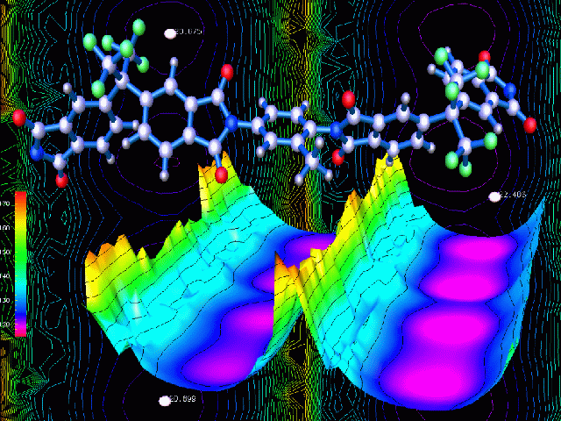


Introduction to
Biomolecular Modeling & Simulation
Summer 2016
Eric J. Sorin, Ph.D.
California State University, Long Beach

Slide 2
Agenda:
What is biomolecular modeling?
Building an all-atom model
Important physical concepts
Molecular dynamics simulations
Monte Carlo Calculations
Data analysis

Slide 3
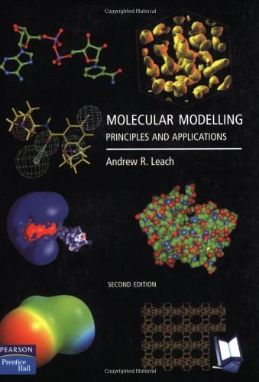
Disclaimer!
First, this is a basic introduction to molecular modeling and MD simulations … The calculations we perform using GROMACS are much more sophisticated than I can cover in ~100 slides!
Make sure you stop me and ask questions as we go!
Also, we have a copy of the Leach book in the lab … consult that if you need more info as it goes in depth on everything we’ll discuss …

Slide 4
Bringing the sciences together:
Biology: the basis of what we’re modeling & simulating
Chemistry: the basis of intra- and inter-molecular interactions (i.e. energies of interaction)
Physics: how we will model biomolecules, solvent, and the environment in which they exist
Math & Stats: to implement models and treat large numbers of molecules as ensembles
Computer Science: without computers we have only ideas, not results!

Slide 5
Computational Biology Subdisciplines
Bioinformatics
Biosimulation
Based primarily on principles from biology and computer science
Examines information in broad contexts
Data analysis performed on experimental data
Limitations based on data abundance and accuracy
Based primarily on principles from chemistry and physics
Examines molecular or system behavior
Data generation using physical modeling
Limitations based on system size and model validation

Slide 6
Goals of Modeling & Simulation
Understand how biomolecular systems behave/function
Calculate thermodynamic, kinetic, mechanistic and structural properties
Gain insight and supplement experiment
Improve modeling, predictive power, and knowledge for design
Collaborate with experimental and analytical approaches
Simulations are thought experiments
performed on computers!

Slide 7
Challenges in Biosimulation
Models are only as realistic as the physics that are considered
Simulation is costly (time & computing power)
Approximations are needed, and must be understood and appreciated
Sampling vs. Accuracy paradigm: the best models are most often too time consuming to be tractable

Slide 8
Computational Cost
Approximate CPU time needed for number of atoms, N
Typical scaling behavior:
Molecular mechanics/dynamics ~ N²
Semi-empirical MO methods ~ N³
Density functional theory ~ N⁴
Ab initio MO methods ~ N⁴, N⁵, N⁶ ...
Slow down for
N = 10,000 atoms
1 (reference)
10⁴
10⁸
10¹²
Going from MD to MO: seconds → years
Going from MD to DFT: seconds → millenia

Slide 9
Mechanical Regimes
We’ll focus on this regime!
Quantum
Mechanics
Ties microscopic quantities to macroscopic quantities in either regime using statistics
Describes molecular systems as mathematical models using the appropriate mechanics for the problem at hand
Statistical
Mechanics
Molecular
Mechanics
Classical Mechanics
“The underlying physical laws necessary for the mathematical theory of a large part of physics and the whole of chemistry are thus completely known, and the difficulty is only that the exact application of these laws leads to equations much too complicated to be soluble.” P.A.M. Dirac, 1929
Notes:
9

Slide 10
Mechanism of Modeling
Software & hardware
Performs calculations, each software package includes various models/methods/treatments
Biomolecular potentials (Force fields)
Defines the energetics/forces in the model
Determines complexity & comp. expense
Approaches
How the simulations are performed: molecular dynamics, Monte Carlo, etc.

Slide 11
Tying it all together
Sequence & structure
Chemical interactions
Ensemble
studied
Environmental conditions
➔
.pdb/CLI
➔
➔
➔
Topology
Energetics
T, P, V, N, constraints, etc.
.gro
➔
.top
.mdp
➔
Molecular Models
Molecular Simulation
.xtc/.trr
➔
& .log
Dynamics & mechanism
&
OR
EQ Thermo.
Quantities
Equilibrium
Ensemble
&
OR
Time dependence
Data Analysis
GROMACS file extensions (CLI = command line input)

Slide 12
Agenda:
What is biomolecular modeling?
Building an all-atom model
Important physical concepts
Molecular dynamics simulations
Monte Carlo Calculations
Data analysis

Slide 13
The simplest chemical system
Pure atomic fluid
No charges to consider
Properties are determined by the attractive and repulsive interactions between atoms
Why do non-polar particles attract?
r_{ij}

Slide 14
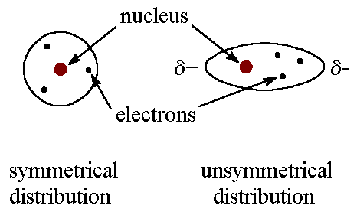
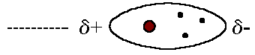
The simplest chemical system
London dispersion (1930)
Electrons are constantly being redistributed
Temporary dipoles are constantly interacting
Weakest intermolecular interaction/force
a.k.a. “van der Waals interactions”
r_{ij}

Slide 15
The simplest chemical system
Pure atomic fluid
No charges to consider
Properties are determined by the attractive and repulsive interactions between atoms
Why do non-polar particles repel?
r_{ij}
Pauli exclusion / electron repulsion
Also considered “hard sphere” repulsion
Only relevant at short distances, energy increases rapidly as particles (atoms) get too close to one another

Slide 16
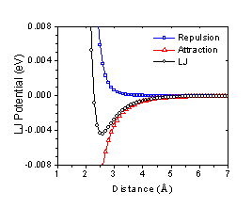
Liquid Argon (“LJ fluids”)
r_{ij}
repulsion
attraction
The Lennard-Jones function combines the repulsion and attraction of particles at short distances
a.k.a. the “12-6 potential”

Slide 17
Liquid Argon (“LJ fluids”)
r_{ij}
Only 2 parameters: σ and ε
σ = separation at zero energy (relates atomic size)
ε = depth of potential energy (minimum at optimal r_{ij})
σ and ε are specific to specific atom types

Slide 18
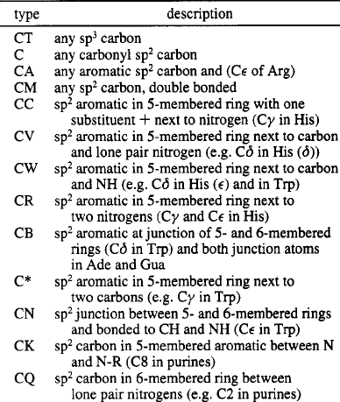
Atom type definitions
An atom‘s behavior depends not only on the atomic number, but also on the chemical bonding it is involved in.
Is it an sp2 or sp3 carbon?
Part of a conjugated system?
Example: carbon atom types from the AMBER all-atom force field
Each can have different LJ parameters σ and ε

Slide 19
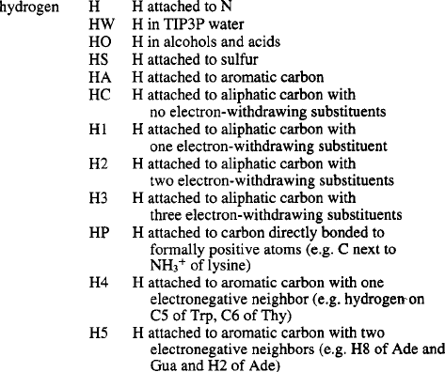
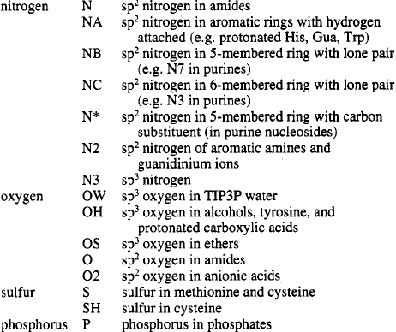
Atom type definitions

Slide 20
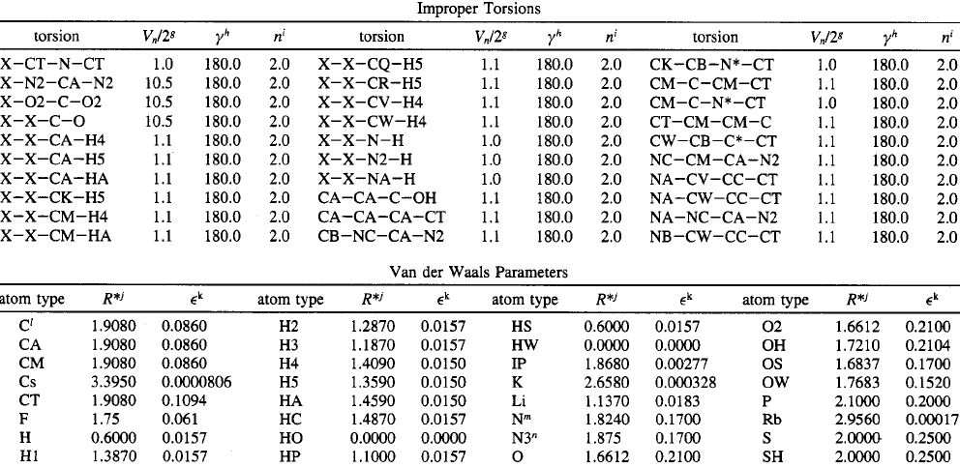
Atom type definitions
The optimal separation and the LJ parameter σ are related
Often (i.e. in AMBER) LJ parameters are given in terms of r* and ε

Slide 21
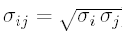
Mixing of atom types
r_{ij}
How do we account for interactions between unlike atom types?
“Combination Rule” depends on the force field:
AMBER: geometric mean
OPLS: arithmetic mean
Combine ε^{’s} and σ^{’s}, then use LJ equation!

Slide 22
2nd simplest case: charged atoms
δ⁺
Easiest way to handle charges: the simple point-charge model
Assign a “partial charge” to each atom center and apply Coulomb’s law to all pairs
δ⁻
δ⁺
δ⁺
δ⁻
δ⁺
δ⁺
δ⁻
1
q₁q₂
1
E₁₂ =
4πε₀
r
ε
Remember: ε₀ is the vacuum permittivity ~ 8.854 x 10⁻¹² C²/N∙m²
An additional dielectric constant ε can also be used
(during the simulation, not as a part of the energy model!)
In general, ε ~ 78 (or 80) for water and 2 < ε < 8 inside proteins

Slide 23
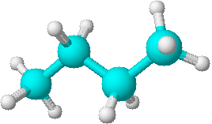
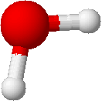
Charge distribution
O: −0.834 e
There are several ways to derive point charges, generally based on molecular geometry and low level QM calculations
Charge interactions are calculated pairwise, but parameterized against experimental or ab initio data: again, intramolecular multi-body effects are accounted for implicitly
Explicit polarization is more difficult, and is now one of the hot topics in molecular mechanics development
H: 0.417 e
C₂: −0.120 e
H: 0.060 e
C₁: −0.180 e
Partial Charges for H₂O
and n-butane (OPLS-AA)

Slide 24
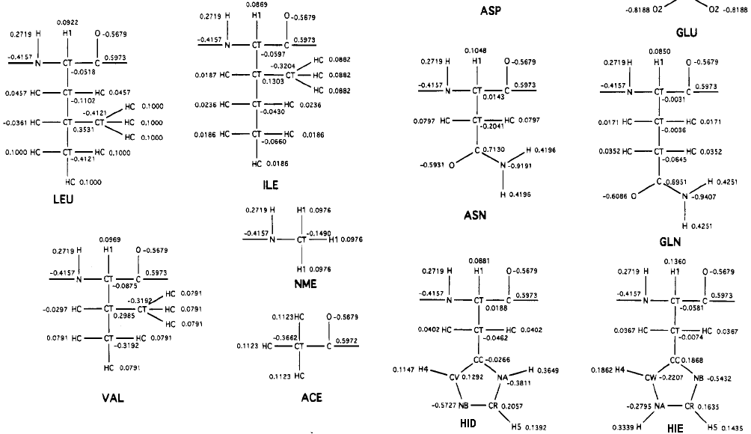
Part of publishing a potential is including the partial charges of each atom in each specific chemical context in which it will be found

Slide 25
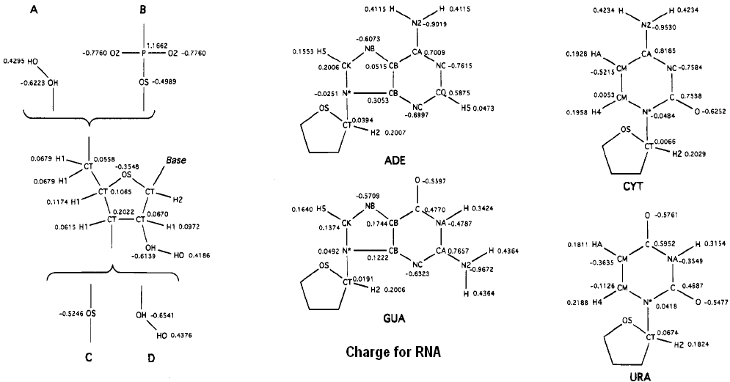
Atomic partial charges
Same atom types and bonding (i.e. topology) inside the boxes
Note the differences in charges for these two RNA‘s: the N* atom is partially negative in one, partially positive in the other

Slide 26
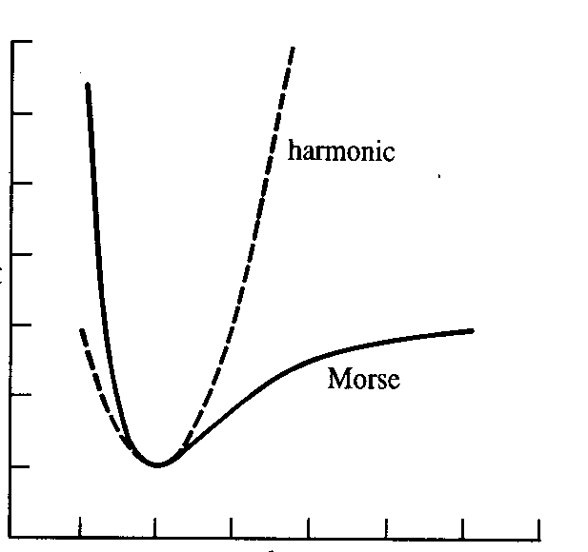
Now let’s add bonds
Most common way to treat bonds in molecular models:
Harmonic: use Hooke’s law
We need only a force constant and bond length for each bonded pair (A–B)
At high T, this will fail as vibrational energies increase rapidly
That’s OK: bio force fields are parameterized for biological temperatures!
E(r)
r

Slide 27
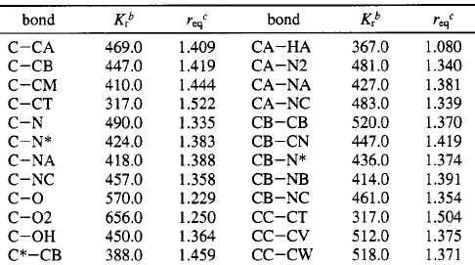
Example bond parameters (AMBER)
Bond parameters needed goes as (# atom types)²
Units depend on software: AMBER uses kcal/mol/Å²
GROMACS uses kJ instead of kcal

Slide 28
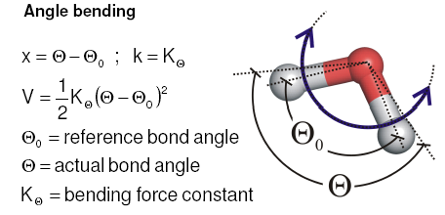
Bond angles
Not surprisingly, angles can be treated identically to bonds: Hooke’s law is applied, 2 parameters needed
Like bonds, higher order terms can refine the model (i.e. for crystal lattice vibration, etc.)

Slide 29
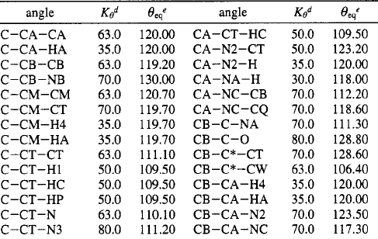
Example angle parameters (AMBER)
Angle parameters needed goes as (# atom types)³
Units depend on software: AMBER uses kcal/mol/rad²

Slide 30



Simple 3-point water models
σ and ε
Parameters needed:
2 LJ parameters for O atom
2 LJ parameters for H atoms
2 partial charges
O–H equilibrium bond length
O–H force constant
H-O-H equilibrium bond angle
H-O-H angle force constants
δ⁻
k_{b}
δ⁺
δ⁺
k_{θ}
Total of 10 parameters are needed just for a simple model of water!

Slide 31
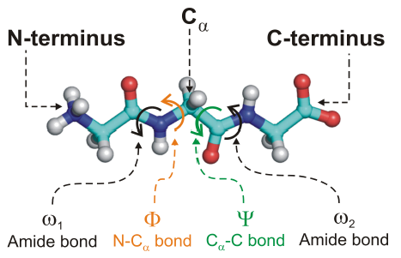
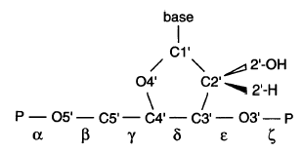
Dihedral potentials
Whenever we have 4 atoms bonded in a row, a dihedral (torsion) results
In proteins we generally talk about φ/ψ torsions
Nucleic acids have 6 backbone torsions
Organic chemistry provides the philosophy to model torsions

Slide 32
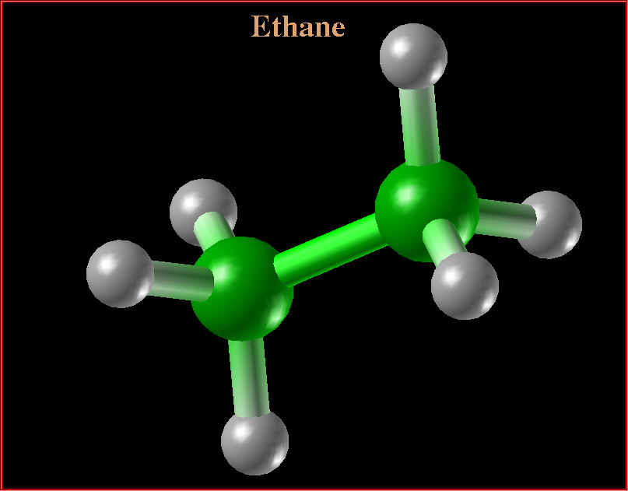
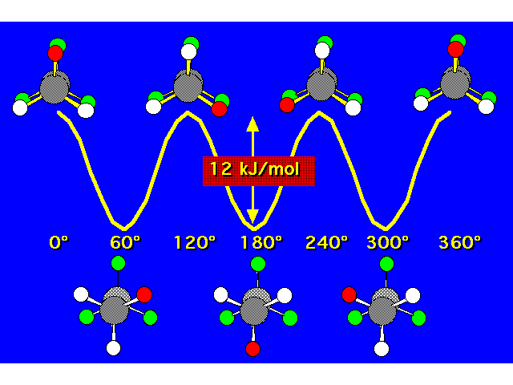
Ethane
Use periodic functions E = k_{φ} [1 + cos(nφ - φ_{o})]
Multiplicity (n): determines number of minima and maxima in the energy function (Ethane has n=3)
Equilibrium torsion angle: (φ_{o}) determines phase (E_{max})
Force constant: determines amplitude (k_{φ})

Slide 33
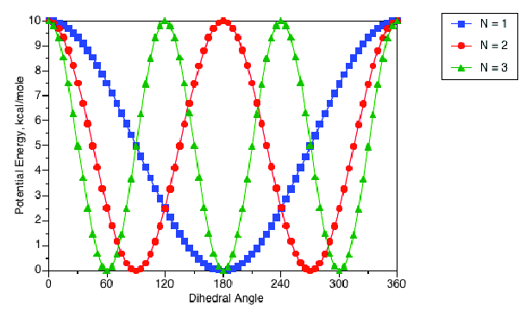
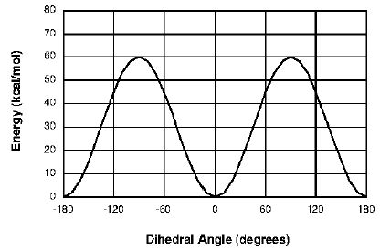
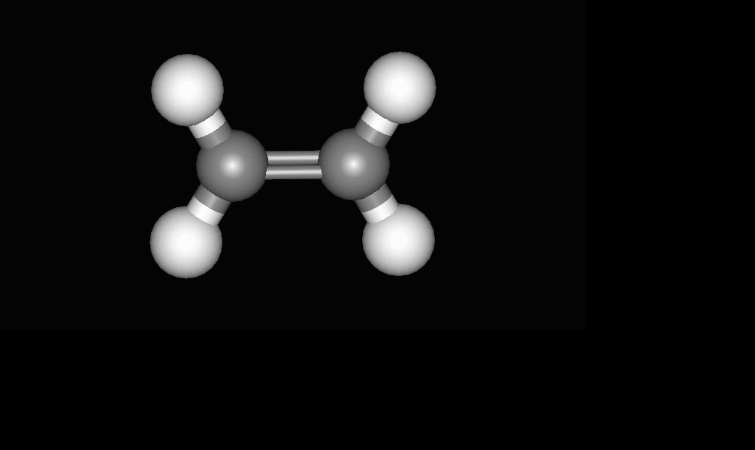
Torsional multiplicity (n)
Strong double bond: hard to rotate/high energy barrier
Should have 2 minima and 2 maxima
ethene

Slide 34
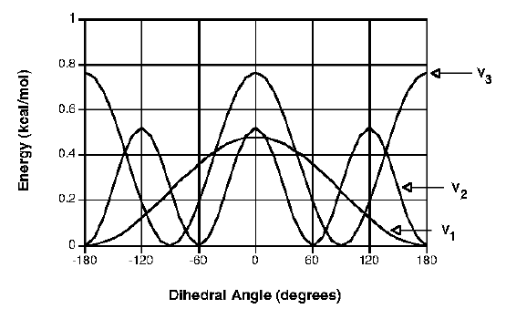
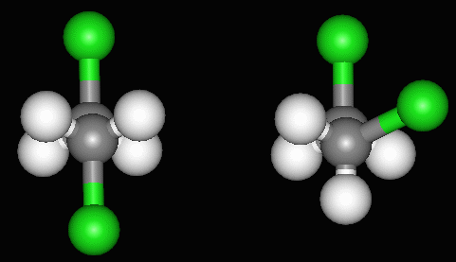
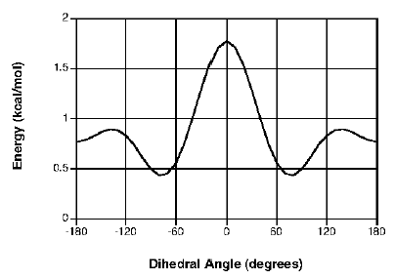
Torsions come in many flavors
We can add multiple torsion terms together to model more complex groups of atoms
dichloroethane
Anti Gauche
The addition of multiple torsions is linear
n differs between cos terms
Relative k_{φ} values weight the contribution of each term
V_{total} = V₁ + V₂ + V₃

Slide 35
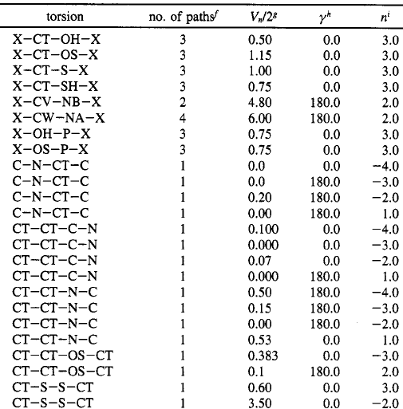
Example torsion parameters (AMBER)
It is common to add multiple torsions together to get the rich/detailed dihedral potential that best fits reality
In general, not all types of torsions are parameterized: only bio-relevant torsions are present
Negative n is used just to tell the software more are coming!

Slide 36
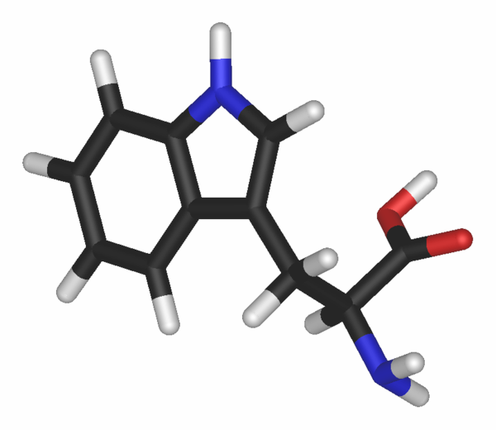
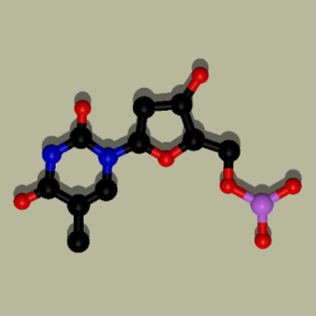
What else are we missing?
tryptophan
thymine
- Need to control out-of-plane motion (i.e. around sp² groups)
- Present in NH₂ groups, rings, etc.
- These “improper torsions” include a quartet of atoms not linearly bonded (1 central atom with 3 bonded atoms)

Slide 37
Improper dihedrals
B'
Central atom B should feel an “energetic penalty” for moving out of the plane to position B’
Two ways to parameterize:
B
C
D
A
Simple: use a harmonic function
Minimum energy (0) set at φ = 0°
Problem: parabolic energy curve, energy can go to infinity, causing simulation to crash (NAN = “not a number“)
More common: apply the torsion potential already in use
E = k_{imp} [1 + cos(nφ – φ_{o})] AMBER
Ε_{imp}(φ) = 0.5 k_{imp} (φ − φ₀)²
CHARMM

Slide 38
Improper dihedrals (AMBER)
Energy
Improper torsion
Very similar to a double bond potential
Multiplicity is n=2
Phase is 180° (planar)

Slide 39
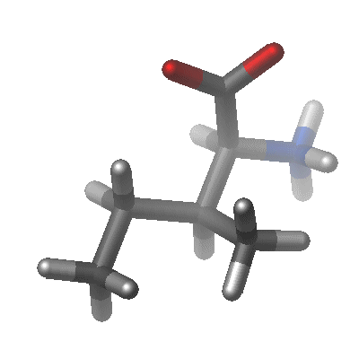
We now have the basis for a molecular mechanical potential
Angle bending
Planar
groups
vdW and qq interactions
Bond stretching
Torsional rotation
The total internal energy is the sum over all such energy terms in a given structure …

Slide 40
Empirical Functional Form
**
E = Σ vdW energy
+ Σ charge energy
+ Σ bond energy
+ Σ angle energy
+ Σ dihedral energy
+ Σ improper torsion energy
**
**
Non-bonded terms – many are distant and contribute ~0, later we’ll discuss some schemes to ignore these
Bonded terms – define sterics and local motions
Which interactions strongly affect conformational preferences in biomolecules?

Slide 41
Empirical Functional Form
← van der Waals
← electrostatics
← bonds
← angles
← Torsions & impropers

Slide 42
Empirical Functional Form
Parameters to define in atomistic force fields:
vdW (2 per atom type)
qq (1 per atom!)
bonds (2 per atom type pair)
angles (2 per atom type triplet)
dihedrals (3 per type quartet)
impropers (3 per type quartet)
Thousands of parameters for AA’s, NA’s, lipids, small molecules, and solvents

Slide 43
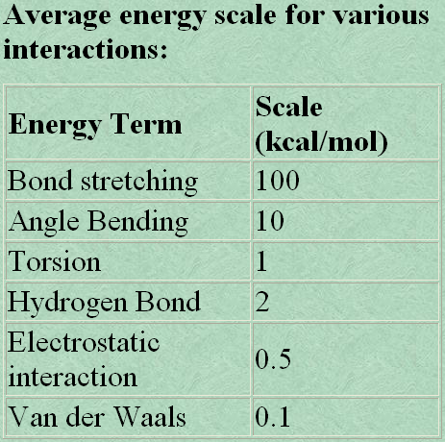
Empirical potential energy scale
An empirical potential is a certain functional form of the potential energy of a system of interacting atoms with the parameters derived from ab initio calculations and experimental data.

Slide 44
Agenda:
What is biomolecular modeling?
Building an all-atom model
Important physical concepts
Molecular dynamics simulations
Monte Carlo Calculations
Data analysis

Slide 45
Protein folding energy landscape
Positions for each atom
3N dimensional space
Local minimum: intermediate?
Free energy
Global minimum:Folded
“native state”
Reaction Coordinate
Local minimum: Unfolded

Slide 46
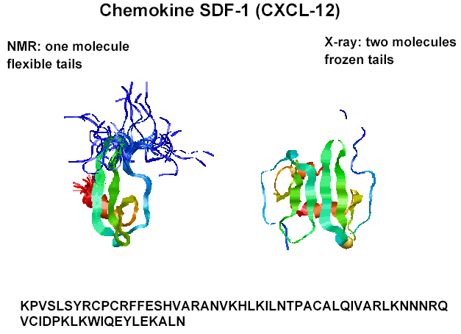
What is the “native” state?

Slide 47
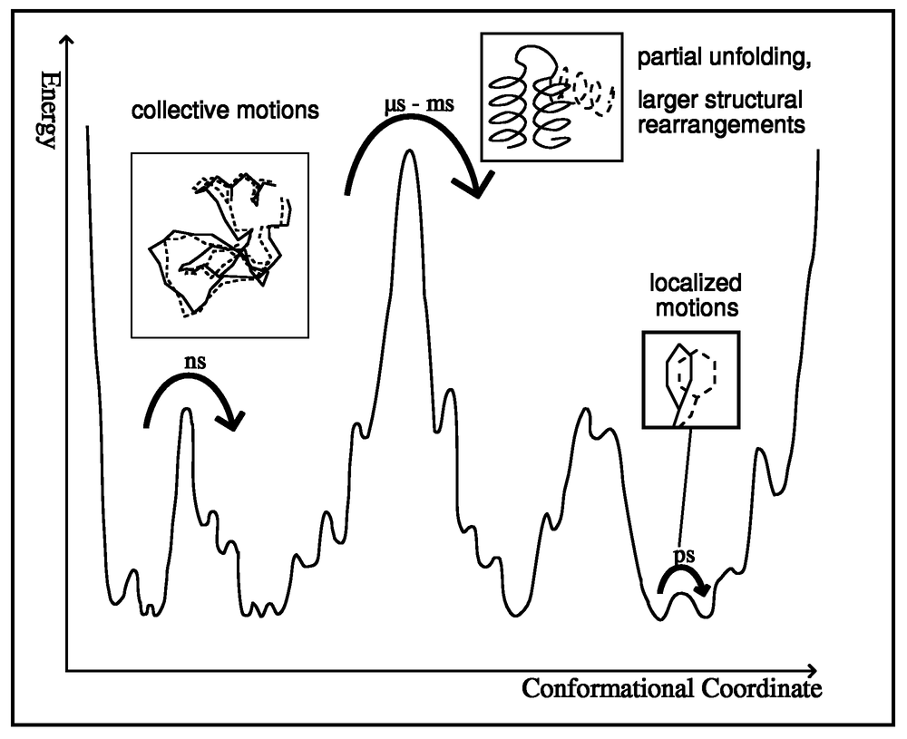
More realistic view
If this barrier is too high, transitions will be too slow to capture with MD simulations … we’ll need Monte Carlo!
The landscape is actually very “rugged” from local interactions that lead to small energy barriers and energy minima
Notes:
00-09

Slide 48
Time Scales of Protein Motions
α-Helix folding
Elastic vibrations of proteins
β-Hairpin folding
Bond stretching
Protein folding
10⁻¹⁵
10⁻¹²
10⁻⁹
10⁻⁶
10⁻³
10⁰
(fs)
(ps)
(ns)
(μs)
(ms)
(s)
RNA folding
Timescales of dynamics determine the computational models & methods that can be applied

Slide 49
Resolution & Sampling
Models are only as realistic as the physics that are considered
Simulation is costly (time & computing power)
Approximations are needed, and must be understood and appreciated
Two important considerations …
Sampling vs. Accuracy paradigm: the best models are most often too time consuming to be tractable
Required resolution: we only need to “see” well enough to answer the question(s) of interest

Slide 50
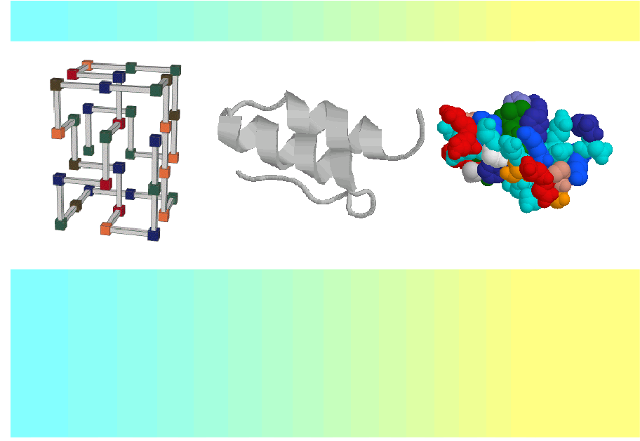
Resolution & Sampling
Sampling
Accuracy
Scales for studying folding
Lattice models
Coarse-grained models
Atomistic models
1000 CPU
years
CPU minute
CPU hour

Slide 51
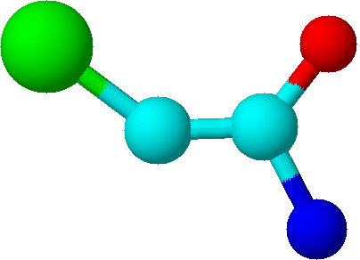
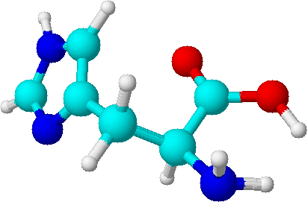
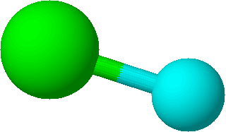
Molecular Representations
All-atom models: accurate, but expensive
United-atom: represent a functional group as a single unit
Coarse Grained: represent large groups (AAs) as spheres
Once the model is chosen, we need to define the analytical functions that will model the physical interactions present in the system!

Slide 52
Energy terms
Total energy is sum of kinetic and potential terms
E(p^{N},r^{N}) = K(p^{N}) + U(r^{N})
Kinetic energy depends only on the 3N velocity degrees of freedom (v_{x}, v_{y}, and v_{z}),
independent of atomic position
Potential energy depends only on the 3N position degrees of freedom (r_{x}, r_{y}, and r_{z}),
independent of atomic velocity
Will be defined by simulation parameters (i.e. T, V, P, μ)
for MD/Brownian simulations
Will be defined by the force field (i.e. “the model”)
for simulation and Monte Carlo

Slide 53
The Model: Biomolecular potentials (aka “Force Fields”)
Defines the “model” being used mathematically
Primary input for calculation/simulation
Accounts for energetics of the physical system being studied
The “model” can be at any desired resolution or level of complexity
Resolution determines both tractability and usefulness of the model
We have to avoid GIGO! (Garbage In, Garbage Out!)

Slide 54
Agenda:
What is biomolecular modeling?
Building an all-atom model
Important physical concepts
Molecular dynamics simulations
Monte Carlo Calculations
Data analysis

Slide 55
Molecular Dynamics is F = ma = –∂E/∂r
F₀
F₀
+
E₀
+
F
F
+
E > E₀
+

Slide 56
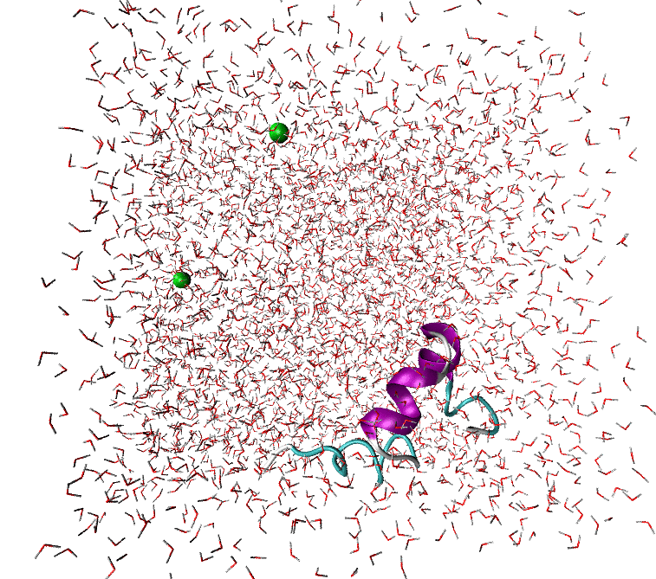
Molecular Dynamics
Atomic data in 4D: time dependent simulation
Example: 36 residue villin headpeice
All atoms are in motion
FF to calculate energies
Energies → forces
Forces are applied to each atom at each timestep
Timestep ~1 fs = 10⁻¹⁵ s

Slide 57
Generate the Trajectory
Solve the differential equations numerically:
A small finite time step Δt.
Conservation of energy:
Kinetic and potential energies can fluctuate, but the total energy should be conserved (~ 0.01%).
Computational effort:
Generate 10⁶ to 10¹⁰ (or as many as possible!) points in the phase space

Slide 58
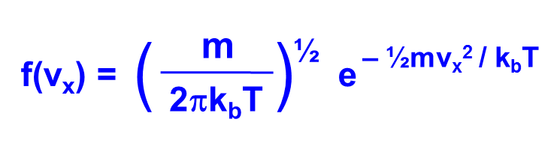
Initial Velocities
Random direction
randomize each vector component independently by choosing point on spherical surface
Magnitude consistent with desired temperature.
Maxwell-Boltzmann velocities
Same for y, z components
Assign randomly to get right temperature
Shift system to get zero center-of-mass momentum
Note that this exponent is just the kinetic energy in units of kT

Slide 59
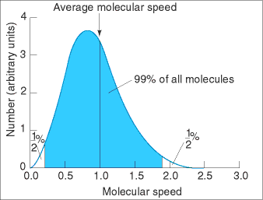
Non-deterministic Scheme
The average speed of nitrogen in air of 300 K is about 520 m/s. The ensemble of speeds is best described by a Maxwell distribution.
Back of the envelope calculation:
500 m/s = 0.005 Å/fs
Particles can move 0.1 Å in a straight line before we calculate forces again
Must recalculate forces every ~20 fs for low density gas phase simulation
In practice 1 fs integration steps are used for solution phase
Notes:
03-15

Slide 60
Time Step size
The time step is determined by the fastest process in the system (X-H vibrational period is a few fs!)
Too small: expensive, subject to round-off errors
Too large: inaccurate, producing artifacts
Too small
Too large
Just fine

Slide 61
Boundary Conditions
Iff we’re using an all-atom model of the solvent, we have to confine the water in some way or it will “drift away” … This goes for ions and co-solutes as well!
Using a “hard-walled” box is not physical relevant
Using a “hard-walled” sphere is OK for some situations (pores, very large systems that remain centered) …
Best method: Periodic boundary conditions (PBC’s)

Slide 62
Boundary Effect
Most experiments measure macroscopic or bulk properties.
(Avogadro’s # of particles , N_{A} = 6.022×10²³ mol^{–1})
A liter of water: one in 1.5 million water molecules interacts with the walls
A drop of 1000 waters: the majority of the waters are interacting with the boundary
Surface region
Bulk
region
Can we minimize the boundary effect and make our simulations more relevant to experimental measurements?

Slide 63
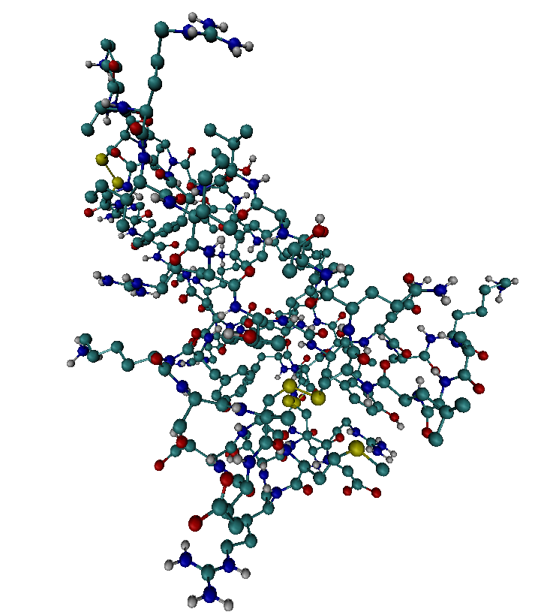
Non-Periodic Boundaries
Active region: normal MD simulations
Buffer region: atoms fixed or restrained to certain positions
We can constrain the water to stay in some volume, but how “real” is the dynamics?
Active
region
If needed, this treatment greatly reduces the number of “mobile” atoms
Buffer
region
There is a better way!

Slide 64
Periodic Boundary Conditions
Pretend we’re simulating bulk conditions!
No hard boundaries used
Soft boundaries allow molecules to pass (green ions)
PBC’s act as an infinite number of identical “cells” in x, y, and z directions
Do atoms on opposite sides of the cell “see each other” across the boundary?

Slide 65
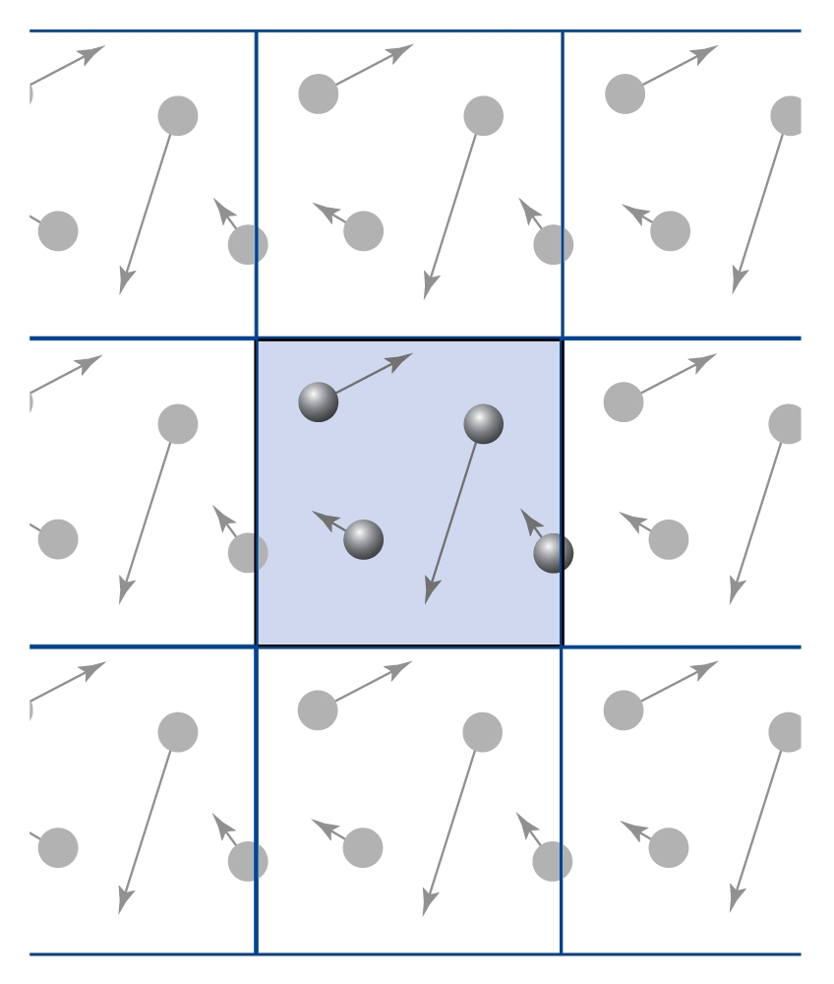
Periodic Boundary Conditions
Infinite Replicas of the “primary” simulation cell
Molecules in any cell have a mirror image counter part in all the other cells
Changes in the “primary” box are matched exactly in all “other” boxes
Surface effects are eliminated
We can examine any box of the right size … they’re the same!

Slide 66
Periodic Boundary Conditions
Problem: we don’t want to calculate the interactions between a particle and one of it’s images
Employ the Minimum Image Convention: a particle centered in a cell can only “see” other particles that are in that cell
This implies that each particle also interacts with only the nearest image of every other particle

Slide 67
Minimum Image Convention
Another way of stating the MIC:
For a box with a side length L,
Particles only interact if they are within a distance L/2 from one another
Conditions:
The box must be much larger than the size of the biomolecule
We are not calculating long range interactions (qq and LJ) for distant particles
Must be careful about qq interactions!
(we’ll get back to this!)

Slide 68
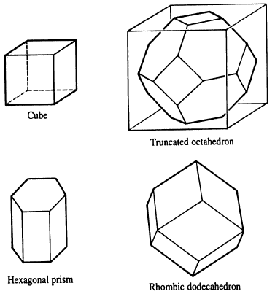
Periodic Boundary Conditions
Several types of simulation cells can be used while applying PBC’s & the MIC
Non-cubic cells might better fit the system being studied and might minimize the amount of solvent being simulated

Slide 69
Issues with PBC’s
Correlations
New artificial correlations?
Suppressed long range correlations
Missing long range motions (larger than the box!)
Considerations
Places a lower limit on box size
Gives a definitive volume from which concentrations can be calculated
Not needed in many cases:
simplified models (i.e. no water present)
Implicit water models or restrained water molecules

Slide 70
Molecular dynamics is very expensive
Example: 1 μs of Molecular Dynamics simulation of F₁-ATPase in water (total 183,674 atoms) needs 10⁹ integration steps, which boils down to 8.4 * 10²⁰ FLOPS.
FYI: FLOPS = Floating Point Operations Per Second
10 GFLOPS = 10,000 MFLOPS ≈ 2.5 GHz CPU (idealized)
on a 10 GFLOPS workstation: ~2.5 years
+ multiple time stepping ~3 months
+ structure adapted multipole methods ~3 weeks
+ parallel computers < 1 day
But 1 μs won’t tell us anything useful about this enzyme!
Notes:
03-33

Slide 71
Limits of Standard MD simulations
Classical description: - Covalent bond changes not described (no chemistry occurs) - Poor description of H-atoms (proton-transfer, acid/base) - Poor description of low-T effects (i.e. Quantum effects) - Simplified electrostatic model (no polarizability)
Only small systems are accessible (10⁴ ... 10⁶ atoms)
Only short time scales are accessible (ps ... μs)
Large biomolecular systems undergo slow dynamics ... Nearly impossible to simulate these systems and see interesting dynamics!
Notes:
03-47

Slide 72
How can we speed up our simulations?
Improve efficiency for all-atom models
Increase the timestep
Cut out calculations of long range interactions (use cutoffs)
Use efficient long range calculation algorithms (Ewald & RF)
Use simplified modeling (a.k.a. “minimalist models”)
Implicit solvent models (lose H₂O molecular description)
United atom models and/or simplified force fields
Coarse-grained models (water can be CG too)
Utilize large computational resources
Cluster computing, multiple processors/job or in parallel
Distributed computing (Folding@Home, etc.)
Employ algorithms that make good use of multiple processors

Slide 73
Fast motions
Hydrogens vibrate the fastest, on the fs timescale
O-H bonds vibrate with a period of about 17 fs
If Δt is too large, H atoms will “fly off” and the simulation will crash due to instability (bond energy calculation → infinity/NaN)
To preserve stability of the integration, Δt needs to be very short
Constrain these fast motions to allow longer timesteps
Fix bond lengths (like H-X) at equilibrium values
Increase timestep to 2 fs – 5 fs, depending on system/model
Several constraint algorithms can be applied
SHAKE, SETTLE, LINCS, etc.
Can be applied to angles as well as bond lengths
d

Slide 74
Cutoffs (a.k.a. Potential truncation)
Non-bonded interactions are expensive to calculate: there many atom pairs to consider (~N²)
Non-bonded interactions decrease with distance
Beyond a certain distance, they can be neglected
R_{m}
R
Use cutoffs to speed the calculations
Define some cutoff distance, r_{cut} (typically 10 to 15 Å)
Calculate pairwise LJ and QQ interactions within r_{cut}
Ignore interactions outside the cutoff distance

Slide 75
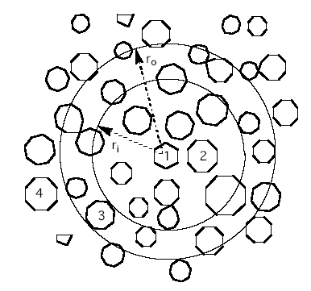
Cutoffs (a.k.a. Potential truncation)
Just using a cutoff will lead to discontinuities in the energies (and forces) at the cutoff distance
As another atom moves across the cutoff radius, it’s presence will suddenly “be felt”
This will result in artificial physics (i.e. artifacts) in the dynamics
How do we fix this?

Slide 76
Cutoffs (a.k.a. Potential truncation)
Just using a cutoff will lead to discontinuities in the energies (and forces) at the cutoff distance
1st Option: Switching function
Choose a 2nd cutoff, r_{off}, at which long range interactions will go to zero
Multiply U(r) by a switching function that tapers the long range interactions to zero between r_{cut} and r_{off} …

Slide 77
Cutoffs (a.k.a. Potential truncation)
Just using a cutoff will lead to discontinuities in the energies (and forces) at the cutoff distance
2nd Option: Shifting function
Shift long range interaction energies (U(r)) up such that they go to zero at r_{cut}
Non-bonded energies will be higher at short distances than defined by the FF
Extend r_{cut} for accuracy

Slide 78
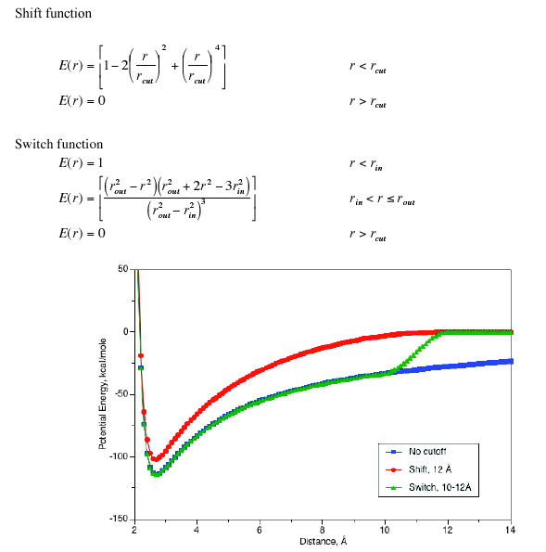
Cutoffs (a.k.a. Potential truncation)
Remember: vdW interactions die off within 8 Å or so
QQ interactions are much longer ranged
Blue: non-truncated potential (true FF)
Dashed: simple 12 Å cutoff to U(r) = 0
Red: potential shifted to U(r) = 0 at 12 Å
Green: potential switched between 10 and 12 Å
Switch is more common than shift as it maintains correct short range energies and forces

Slide 79
Cutoffs (aka Potential truncation)
Use cutoffs to speed the calculations
Define some cutoff distance, r_{cut} (typically 10 to 15 Å)
Calculate pairwise LJ and QQ interactions within r_{cut}
Just ignore interactions outside the cutoff distance?
Are long range QQ interactions important?
NO: neutral systems w/o counterions, small charges
MAYBE: charged proteins, counterions, etc.
YES: Nucleic acids & other highly charged systems
How do we account for this?
Methods to approximate long range QQ interactions
Most commonly used methods are “Ewald“ (PME for nucleics) and Reaction Field (RF for proteins)

Slide 80
OK, so what’s next?
We have a system (biomolecule + ions + water)
We choose a force field (based on current knowledge)
We choose simulation conditions (match experiment?)
We feed this info into GROMACS with additional info:
Timestep & frequency to “dump” data
PBC’s & cutoffs
Constraints & long range corrections (PME, RF, etc.)
Initial velocities
We energy minimize the system and anneal the solvent
We run a simulation and wait for it to complete (or we monitor it while it is running)

Slide 81
Agenda:
What is biomolecular modeling?
Building an all-atom model
Important physical concepts
Molecular dynamics simulations
Monte Carlo Calculations
Data analysis

Slide 82
Motivation for MC
MD cannot sample large ensembles of many microstates
Timescale is the limiting factor in MD, non-ergodic results
MD is good for assessing mechanism, dynamics, and rates, but not efficient for sampling thermodynamics
We don’t need time-dependent data for thermodynamics
MC offers the needed approach and most calculations we discussed for MD can be applied to MC:
Thermostats and barostats to sample NVT, NPT
Cutoffs, long-range interactions, neighbor lists
Explicit & implicit solvents, PBC’s and the MIC
MC cannot give kinetics/dynamics/mechanism
MC can function with ANY type of energy function (MM, QM, etc)

Slide 83
Simulation techniques
Energy minimization (EM)
Molecular dynamics (MD)
Langevin / Brownian Dynamics (LD/BD)
Monte Carlo (MC)
Time
averages
Ensemble
averages
Stochastic: Relies on random sampling and/or random numbers via thermostat/barostat
Deterministic: Relies on classical mechanics (for
the NVE ensemble, NPT is not “pure” MD)

Slide 84
How is MC “random”?
N_{i}
The Boltzmann Distribution Law tells us the relative weights of two microstates
– ΔE / k_{b}T
=
e
N_{j}
The partition function (Z) for an ensemble defines the probability distribution of ALL microstates in that ensemble: ∑ e^{– E /kT} for all i
_{i}
N_{i}
e
– E_{i} / k_{b}T
The Boltzmann weight for microstate i ties the energy to the probability P(Γ_{i})
=
= P(Γ_{i})
N
Σ
e
– E_{j} / k_{b}T
all j
This applies to the canonical ensemble (NVE) … what about NPT?
For solution phase ΔV ~ 0, so no work is done and the isothermal-isobaric distribution approaches the canonical distribution

Slide 85
How is MC “random”?
N_{α}
The Boltzmann Distribution Law tells us the relative weights of two microstates
– ΔE / k_{b}T
=
e
N_{β}
A transition α → β is favorable (will occur) if E(α) > E(β)
When E(α) = E(β) the transition probability for α → β
is equal to that of β → α (they’re degenerate)
For E(α) < E(β), the transition is not favored, but is still
possible if environmental energy (kT) is adequate
As E(β) increases, this transition becomes less likely
The Boltzmann factor describes this likelihood based on
energetics …

Slide 86
Metropolis Monte Carlo
In 1953, Metropolis first instituted Monte Carlo based on
the following algorithm for LJ fluids:
start in some initial state (i)
attempt a “trial move” to some new state (i + 1)
accept the move if favorable (E_{i+1} ≤ E_{i})
if not favorable (E_{i+1} > E_{i}) accept the move according
to the Boltzmann probability of e^{-ΔE/kT}
How do we employ the Boltzmann probability?
draw a random number uniformly from 0 ≤ ξ ≤ 1
calculate e^{-ΔE/kT} and compare to ξ
accept the move if ξ < e^{–ΔE/kT}
otherwise, deny move & stay in the current configuration
Boltzmann weighting is often called the “Metropolis criterion”

Slide 87
Metropolis Monte Carlo
E_{i}
E_{j}
Trial move
E_{i}/kT E_{j}/kT ΔE_{ij}/kT e^{-ΔE/kT} Chance of acceptance
8 7 -1 2.718 100%
8 8 0 1 100%
8 9 +1 0.37 37%
8 11 +3 0.05 5%
8 13 +5 0.0067 0.67%

Slide 88
Metropolis Monte Carlo
Protein Thermodynamics
(and function?)
Protein
Structure
Goal
Random
displacement
~10⁶ steps
Evaluate
energies
Update ensemble
Analyze
Yields ensemble averages, but no connection between microstates i and j in time
Accept or
reject
How do we know when the MC has converged?
Detailed balance!

Slide 89
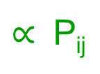
Detailed Balance
In equilibrium, the rates between any two microstates must be equal
Γ_{i} Γ_{j}
Must be possible to maintain based on the move set
Provides a good “litmus test” for reaching equilibrium
If detailed balance is not met, no steady state and equilibrium not reached
r_{ij}
r_{ji}
N_{i}
N_{j}
r_{ij} = r_{ji}
$∝$ P_{ij}
= P_{ji}
N
N

Slide 90
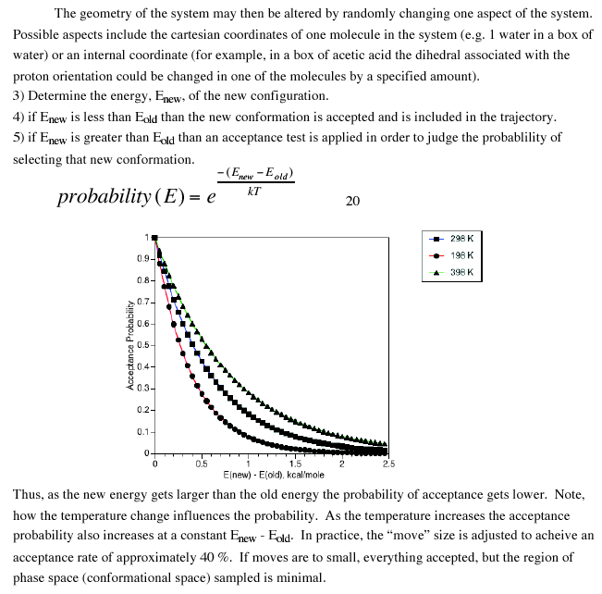
Metropolis Monte Carlo
The acceptance probability is a function of T
At higher T, there is more ambient energy (larger kT) to help the molecule jump to higher energy microstates
At lower T, less ambient energy means less likelihood of jumping to high energy microstates
The “move set” also determines the acceptance probabilities

Slide 91
Metropolis Monte Carlo
Large moves tend to cause large changes in energy and low acceptance probability
Small moves tend to cause small energy diffs and high acceptance probability
Aim for P_{acc} ~ 50%
Free energy
Reaction Coordinate

Slide 92
Monte Carlo “moves”
The “move set” depends specifically on the type of problem.
Protein structure: random rotation around randomly chosen backbone bonds, sidechain bonds, etc.
A long series of random moves is generated with only some of them considered as “good” moves.
Move sets can consist of multiple uncorrelated moves.
Change a torsion and an angle in one step
Change several atom positions in a single step
Translation of the molecule in 3D space
There are infinite possibilities, so be sure you understand what the move set is before assessing
Are they limiting any portions of the phase space?

Slide 93
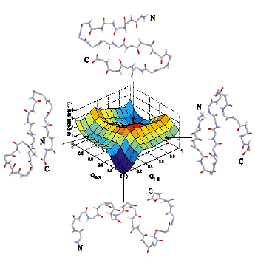
Example: protein torsional MC
Constrain all non-torsional motions
The free energy surface is built into the model (the FF and the MC ensemble)
Random changes must not rule out portions of this free energy surface
Good sampling will provide P(Γ_{i}) for each microstate

Slide 94
MD versus MC
Energy and force are needed
Need added algorithms to constrain some degrees of freedom
Consecutive configurations are very similar
MD moves simple and complex systems in the
same way
Same time step can be used for small or large systems
Can’t easily get thermodynamic information for large systems
Only energy is needed
Easy to constrain some degrees of freedom (not include them in move set)
Consecutive configurations can be very different
Hard to design move set for complex systems, due to collective motions, etc.
Step size decreases with system size
Can’t easily get kinetic or mechanistic information (although some try)

Slide 95
Agenda:
What is biomolecular modeling?
Building an all-atom model
Important physical concepts
Molecular dynamics simulations
Monte Carlo Calculations
Data analysis

Slide 96

Downloading and visualizing pdb files
Protein Data Bank → http://www.rcsb.org/pdb/
3D (xyz) coordinates in (Å)
Methods: NMR, X-ray, other
Resolution of structure
Additional info on each structure
References for the structure determination

Slide 97

Example PDB file
This is what your data looks like at each “snapshot” …
From these atomic coordinates we can calculate nearly anything we desire
We can generate text files, so you can use Gromacs tools or you can code up analysis tools by hand to process these atomic coordinates …

Slide 98
Data Analysis
(1) You need a question!
(2) You need a conceptual way to answer your question …
(3) You need reaction coordinates to represent your conceptual answer!
(4) You need a script to calculate the RC’s you want to examine
Does ligand binding cause a change of shape/structure in the enzyme cavity?
Let’s compare the structure of the binding pocket (as a function of time?) to the starting structure of the pocket.
RMSD & Rg might work here, but we can also compare specific residues
Ah-ha! That’s what perl/python is for! Time to start scripting…

Slide 99
What it boils down to …
Devise a way to answer those questions
Decide which RC’s best serve your needs
Identify your
questions
Calculate ensemble average values (+/- SD)
Use the resulting numbers to answer your question(s)
Write a script to calculate those RC’s over all of your data
Draw conclusions, assess data quality & analysis strength
Calculate correlations between quantities
Calculate time-dependence of variables of interest

Slide 100
Common Reaction Coordinates (Structure)
Radius of gyration (R_{g}): measure of absolute molecular size
Root-mean-squared-deviation (RMSD): numerical comparison between two structures (typically compare time t to time t₀)
Solvent accessible surface area (SASA): measure of protein surface exposed to solvent (can be hydrophobic &/or hydrophilic)
Secondary structure content (N_{α}, N_{β}): how much of the protein is in a given 2’ state … “DSSP” assigns 2’ structure type based on geometry and H-bonds
Hydrogen bonds: many ways to calculate H-bonds and use them as reaction coordinates
Native contacts (NC): fraction or number of long range contacts (observed in the native state) present in a given conformation

Slide 101
Common Reaction Coordinates (Energy & Motion)
Potential energy (U or E_{pot}): absolute measure of molecular energy of the biomolecule (determined by model used)
Root-mean-squared-fluctuations (RMSF): absolute measure of the spatial fluctuation of individual atoms or groups
Normal mode analysis (NMA)
Principal component analysis (PCA)
Transition rate constants (k_{f}, k_{r}): rates of transfer between states, as discussed in general chemistry
Diffusion constants: rates of motion within a given medium, as discussed in general physics
Many other possible reaction coordinates based on the system(s) and process(es) being studied!!!

Slide 102


Radius of gyration (R_{g})
Numerically describes the overall mass-weighted spread of atoms around a molecular center of mass
m_{i} = mass of atom i
r_{i} = is the distance
between atom i
and the COM
$R_{g}= \sqrt{\frac{\sum_{i}{{m_{i} r}_{i}^{2}}}{\sum_{i}{m_{i}}}}$

Slide 103
Radius of gyration (R_{g})
Numerically describes the overall mass-weighted spread of atoms around a molecular center of mass
$R_{g}= \sqrt{\frac{\sum_{i}{{m_{i} r}_{i}^{2}}}{\sum_{i}{m_{i}}}}$
Small molecules R_{g} < 5 Å Peptides R_{g} < 10 Å
Proteins R_{g} ~ 25 Å Huge proteins R_{g} > 50 Å
Can be directly compared to SAXS experiments!

Slide 104

Root-mean-squared-deviation (RMSD)
After structural alignment, measures the mean distance between atoms in two structures or at two times
RMSD $= \sqrt{\frac{\sum_{i}{m_{i}{ [r_{i}(t_{1}) − r_{i}(t_{2})]}^{2}}}{\sum_{i}{m_{i}}}}$
m_{i} = mass of atom i
r(t₁) – r_{i}(t₂) = distance between atom i at times t₁ and t₂
Identical structures RMSD = 0 Å
Similar native structures (small protein) RMSD < 3 Å
Similar native structures (large protein) RMSD < 6 Å
Native and denatured protein RMSD > 10 Å

Slide 105


RMSD and Rg Trajectories
Relaxation of a small protein during the first
2 ns of molecular dynamics simulation

Slide 106

Surface areas
Several surface areas may be desired, such as
Hydrophobic SA
Hydrophilic SA
Solvent accessible SA
How to calculate surface areas?
Can we just use the van der Waals surface?
No: the vdW surface may have
grooves that are too small for
H₂O occupancy

Slide 107
Surface areas
The most common SA calculation is based on the Connolly method … a.k.a. the “Connolly Surface”
Roll a ball of radius r around on the surface of the protein and sum the surface units that ball can “touch”
The radius is generally 1.4 Å, corresponding to r_{H2O}
The model used determines which atoms are hydrophobic vs. hydrophilic

Slide 108

Surface areas
Relaxation of the SASA of two proteins in molecular dynamics simulations
Generally, a smaller SASA is “better”
Only true for hydrophobic surface areas
Note the rapid transitions that lead to smaller SASA in the top frame
(i.e. “molecular collapse”)

Slide 109
DSSP
GOAL: given a protein structure, determine which residues are in helical, beta, or turn conformations
DSSP developed by Kabsch and Sander, 1983
Determine 2’ protein structure by considering backbone torsions and hydrogen bonding patterns
8 structural types recognized
~ Coil E B-Sheet
B B-Bridge S Bend
T Turn H A-Helix
I 5-Helix G 3-Helix

Slide 110

DSSP for a helix simulation
t = 0
t = n
Res 1
Each column describes the 2’ structure at a given time
Sum the helical residues to get N_{helix}(t)
Sum the beta residues to get N_{beta}(t)
Res n

Slide 111

DSSP output
More commonly, where few simulations are present, a graphical form of DSSP output is provided
“Color blocks” emphasize persistent structure

Slide 112

Hydrogen bonding
How to determine H-bonding from a single static structure?
θ
Must account for all donor and acceptor atoms
Donor-acceptor distance within a specified range
Generally d < 3.5 Å
Atom-donor-acceptor angle is within a specified range
Generally θ < 30°
~3.0 Å

Slide 113
Hydrogen bonding
How to determine H-bonding from a single static structure?
θ
Count all such Hbonds for each structure (or timepoint) in the simulation
Count Hbonds between different groups in the data set
Protein-Protein / NA-NA
Biomolecule and H₂O
Docking/Binding species
~3.0 Å

Slide 114

Root-mean-squared-fluctuations
Numerically characterize the standard deviation in atomic positions of each atom …
Describes the flexibility (or lack thereof) in a given region of sequence
Comparable to experimental measurements such as NMR
Poor agreement for these residues … not flexible in MD!
Maybe MD had not reached the timescale of this motion?

Slide 115

PES’s & FES’s
We can use potential or free energy surfaces to characterize the thermodynamics (states, barriers, etc.)
Shown below is the FES as sampled by 3 different tRNA folding pathways (classes I, II, and III)
The RC’s measure 2’ and 3’ structure formation (Q₂ and Q₃)

Slide 116

PES’s & FES’s
We can also merge these ideas to study the folding mechanism that occurs as the molecule samples the FES

Slide 117
Questions?

